Slide 1
Deviations in Procurement

Slide 2
DISCLAIMER: This presentation does not replace or supersede law, the procurement manual, policies, or official guidance documents. In the event of a conflict, the foregoing items control.

Slide 3
Presentation Agenda
Overview of “Normal Procurement”
Laws and Statutes
Defining “Deviation”
Deviation Forms: Examples
Resources
Examples of Deviations
How to Submit in E1

Slide 4
Defining Procurement Terms: Goods and Services

Slide 5
Procurement 101 Goods
Items, Physical “Things”
Supplies
Vehicles
Equipment

Slide 6
Procurement 101 Services
The Action of Performing a Task
Custodial Office Cleaning
Lawn Maintenance
Consulting

Slide 7
Now We Know What a Good/Service is, We must Understand the Process for Procuring

Slide 8
Assigned Dollar Value Thresholds for the Procurement of Goods and Services

Slide 9
Dollar Thresholds: Goods
$0-$5000 = Purchase Card
$5,000.01-$24,999.99 = Open Market Purchase- 3 written/verbal bids encouraged
$25,000-$49,999.99 = Informal bid process
$50,000+ = Formal Bid Process

Slide 10
Dollar Thresholds: Services
$0-$49.999.99 = Competition not Required (but Encouraged)
$50,000+ = Formal Bidding Process

Slide 11
Now That we Have Context for Standard Procurement Procedure

Slide 12
Let’s Examine Laws Around Procurement, and divergences from the Standard Procedure

Slide 13
Differences between Exception and Exemption
Exception:
Normally applies, but in this case does not
Exemption:
Never applies to this situation

Slide 14
WARNING ON EXEMPTIONS!
Just because the particular purchase might be exempt from standard procurement law, DOES NOT MEAN THAT NO LAWS APPLY (situation-specific laws may govern)
Exemptions may not be from all standard procurement law – just some procurement law (e.g., contracts still must be entered into the accounting system)
Consult your friendly agency legal professional

Slide 15
Procurement Laws and State Statutes

Slide 16
Nebraska Revised Statutes 81-161.01
Goods Exceptions: “Competitive bids; time requirements; waiver.”
“A minimum of fifteen days shall elapse between the time formal bids are advertised and the time of their opening, except that this requirement may be waived by the materiel administrator upon a showing by the using agency of an emergency, sole or specialized source, or other unique requirement.”

Slide 17
Goods Exemptions 81-146
Erection, construction, or original equipment of any building or addition thereto
Construction of any road or bridge
Performance of any “like work” (to above)
Products used by inmates (CSI)
Leasing of real property

Slide 18
Direct Purchase Authority 81-161.03
The materiel division may, by written order, permit purchases, contracts, or leases to be made by any using agency directly with the vendor or supplier whenever it appears to the satisfaction of the materiel division that, because of
the unique nature of the personal property,
the price in connection therewith, the quantity to be purchased,
the location of the using agency,
the time of the use of the personal property,
or any other circumstance,
the interests of the state will be served better by purchasing or contracting direct than through the materiel division.

Slide 19
Direct Purchase Authority 81-161.03 & 9 Neb. Admin. Code. ch. 1, Sec. 006
Cannot exceed one year (statutory)
Revocable (statutory)
Must report acts, expenditures, and proof of competition as required by the materiel division (statutory)
Agency must submit a request in writing to SPB that demonstrates why the interests of the state will be served better by not purchasing or contracting through the materiel division (regulation)
Ensure requests above $49,999.99 have Jennifer Sommars-Link included on the email

Slide 20
Restrictive Competition
Restrictive: limited to a particular brand or certain specifications that significantly narrow pool of competitors
Still competitively bid
Process as a goods deviation
Does not apply to services

Slide 21
Nebraska Revised Statutes Chapter 73
Chapter Titled “Public Lettings and Contracts”
Sections 501-510
Standard Procurement Procedure Guidelines
73-507: “Exceptions”
Deviations from Standard Procedure

Slide 22
Chapter 73-507: Exceptions and Exemptions

Slide 23
(1/5) Nebraska Revised Statute 73-507
EXCEPTIONS (Deviations)
Sole source contracts
Emergency contracts
Contracts for services when the price has been established by the federal General Services Administration (GSA)
Competitively bid by another state or group of states, a group of states and any political subdivision of any other state, or a cooperative purchasing organization on behalf of a group of states; and
Other circumstances or specific contracts when any of the requirements of sections 73-504, 73-508, and 73-509 are not appropriate for or are not compatible with the circumstances or contract.

Slide 24
(2/5) Nebraska Revised Statute 73-507
EXEMPTIONS
Contracts for services subject to the Nebraska Consultants' Competitive Negotiation Act;
Contracts for services subject to federal law, regulation, or policy or state statute, under which a state agency is required to use a different selection process or to contract with an identified contractor or type of contractor;
Contracts for professional legal services and services of expert witnesses, hearing officers, or administrative law judges retained by state agencies for administrative or court proceedings;

Slide 25
(3/5)Nebraska Revised Statute 73-507
EXEMPTIONS
Contracts involving state or federal financial assistance passed through by a state agency to a political subdivision;
Contracts with a value of $15 million dollars or less with direct providers of medical, behavioral, or developmental health services, child care, or child welfare services to an individual;
Agreements for services to be performed for a state agency by another state or local government agency or contracts made by a state agency with a local government agency for the direct provision of services to the public;

Slide 26
(4/5) Nebraska Revised Statute 73-507
EXEMPTIONS
Agreements for services between a state agency and the University of Nebraska, the Nebraska state colleges, the courts, the Legislature, or other officers or state agencies established by the Constitution of Nebraska;
Department of Insurance contracts for financial or actuarial examination, for rehabilitation, conservation, reorganization, or liquidation of licensees, and for professional services related to residual pools or excess funds under the agency's control;

Slide 27
(5/5) Nebraska Revised Statute 73-507
EXEMPTIONS
Department of Transportation contracts for all road and bridge projects;
Nebraska Investment Council contracts; and
Contracts under section 57-1503.

Slide 28
Now That We Understand the Laws that Govern Procurement

Slide 29
Let’s Take a Closer Look at Examples of Deviations

Slide 30
Defining a Deviation
Deviation:
“The action of doing something that is different from the usual or common practice”
In Procurement:
“The action of requesting or processing an exception to standard procurement law through SPB ”

Slide 31
Important Note: Procurement Deviations
Only for specific circumstances
Must follow State Statute, to uphold fair and equal practices

Slide 32
Common Deviation Types
Cooperative Contracts
Sole Source
GSA
General Services Administration
Emergency Contracts

Slide 33
What Deviations Cannot be Used for

Slide 34
Deviations Cannot… Renew/Extend
1 year contract
4 renewal periods (written in contract)
1 extension for half of initial period
If needed
CANNOT use a deviation to extend the life of a contract
Example:

Slide 35
Deviations Cannot… Amend
CANNOT use a deviation to change the original scope of the contract
Duties
Type of Work
Add goods outside original scope
Etc

Slide 36
Deviations Can Only Be Used to Create a New Contract

Slide 37
Cooperative Contracts Statute 73-507

Slide 38
Cooperative Contracts: Statute 73-507
“contracts bid by another state…states… with the intention that multiple entities will be purchasing with…”
Already Competitively Bid contract
“Participating Addendum”
Creates relationship between states using a master agreement
“shared” amongst entities
Benefit: More efficient than fresh start of bid process
How to find Coop Contracts
Search cooperative purchasing organizations (e.g., NASPO)
Reach out to peers in other states
Ask the vendor

Slide 39
Sole Source Contracts Statute 73-502

Slide 40
Sole Source: Services Statute 73-502
“Such a unique nature that the contractor selected is clearly and justifiably the only practicable source to provide the service”
Based on Uniqueness of service/good, or availability at the location required
Should be very Specified/Specialized
Must be Legitimately the Only Source
Suggested: Contact Agency Law Specialist or SPB for Questions if a Contract Should be Sole Source
Different from Co-Op, Not Competitively bid.

Slide 41
Sole Source Requests
Specifications should not be inauthentically narrow
Should not be used to avoid the bidding process
Should not be because previous familiarity with a vendor/have done business for a long period of time
Coming to the end of a long/complex contract?
Should not award out of convenience/lack of planning

Slide 42
Sole Source Requests: Strong/Weak Examples

Slide 43
Weak Sole Source Request Examples
Agency likes/prefers this Vendor
The Vendor will give the state a really Good Deal™
A Sole Source was Granted in the Past
The Agency has Utilized the Vendor for a Long Time
The Vendor has Particular Experience that Would Make Them Better for the Job.

Slide 44
Strong Sole Source Request Example
Literally Only One Vendor Who Provides Good Or Service
Other Vendors, only one who can provide what is needed, when it is needed, where it is needed.
One Other Vendor, but have a proven record of unreliability/unresponsible. Leaving one vendor option

Slide 45
Participation!

Slide 46
Sole Source Examples: Weak, or Strong? (Participation Game)

Slide 47
Need: Historic Limestone restoration on Capital South Wall
“Westside Stone Masonry” – Only Stone Mason in NE that specializes in historical limestone restoration
Strong Example – Legitimately the only source

Slide 48
Need: 30 Benches for Parks, within 6 months for State Fair
3 Vendors, Only 1 can deliver in Required Timeline, Sole Source for that Vendor
Strong Example - only Vendor who can provide what is needed, when it is needed, where it is needed.

Slide 49
Need: New Tower for Communications
“Towers R Us” – Great to work with last time, so good Jason is going to write specs so they are the only ones we can use
Weak Example – Shouldn’t award because you like the vendor

Slide 50
Need: Repaint of Offices in 501
“Paint the Town”– Was awarded a Sole Source contract for the last job for 501, so we should use them again
Weak Example – Shouldn’t award a Sole Source because one was granted in the past

Slide 51
Emergency Contracts Statute 73-502

Slide 52
Emergency’s: Defined as…
Meeting Urgent requirement
Meeting Unexpected requirement
Risk to health and public safety
Risk to conservation of public resources

Slide 53
Emergency Contracts Statute 73-502
Agency does NOT require AS/SPB approval for this type of contract in the event of an emergency
Agency Director is the decider of when a situation qualifies as an emergency
3 Days From Contract Start to Input Paperwork
Different from Co-Op, Not Competitively bid.
For Goods: Requires Governor Consent/Approval

Slide 54
Note: SPB Does NOT Weigh in on Emergency Status.

Slide 55
Example of an Emergency Contract

Slide 56
Emergency Contract Example
Public Health/Resources
Oil Tanker train spill
Pandemic Spending
Wildfires encroaching on Omaha
Hazardous material spill
Note: Is there an already competitively bid on/is less immediate in time frame?
Attempt search for Co-op Contract

Slide 57
General Services Administration Statute 73-507
GSA

Slide 58
General Services Administration Statute 73-507
“GSA provides workplaces by constructing, managing, and preserving government buildings and by leasing and managing commercial real estate. GSA's acquisition solutions offer private sector professional services, equipment, supplies, and IT to government organizations and the military.”
- GSA.gov “About Us”
Similar to Cooperative Contracts
Already bid contracts, but on the Federal level
GSA

Slide 59
Required Form “Procurement Exception/Deviation Form”

Slide 60
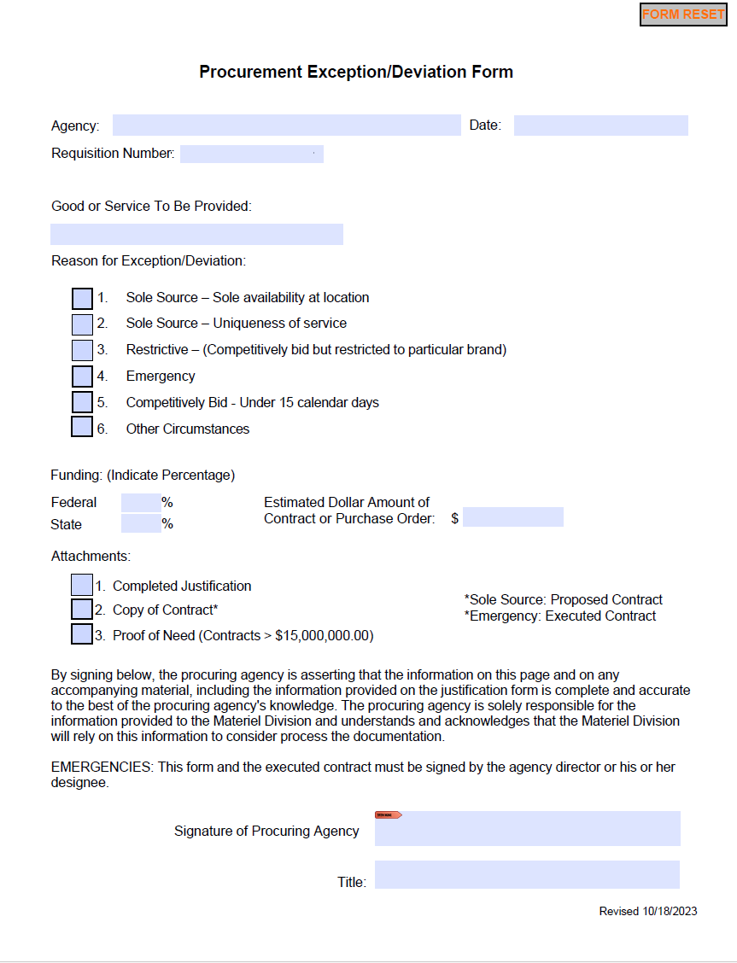
Agency Information
Designation: Good, or Service?
Estimated Dollar Amount
Required Attachments
Agency Director Signature

Slide 61
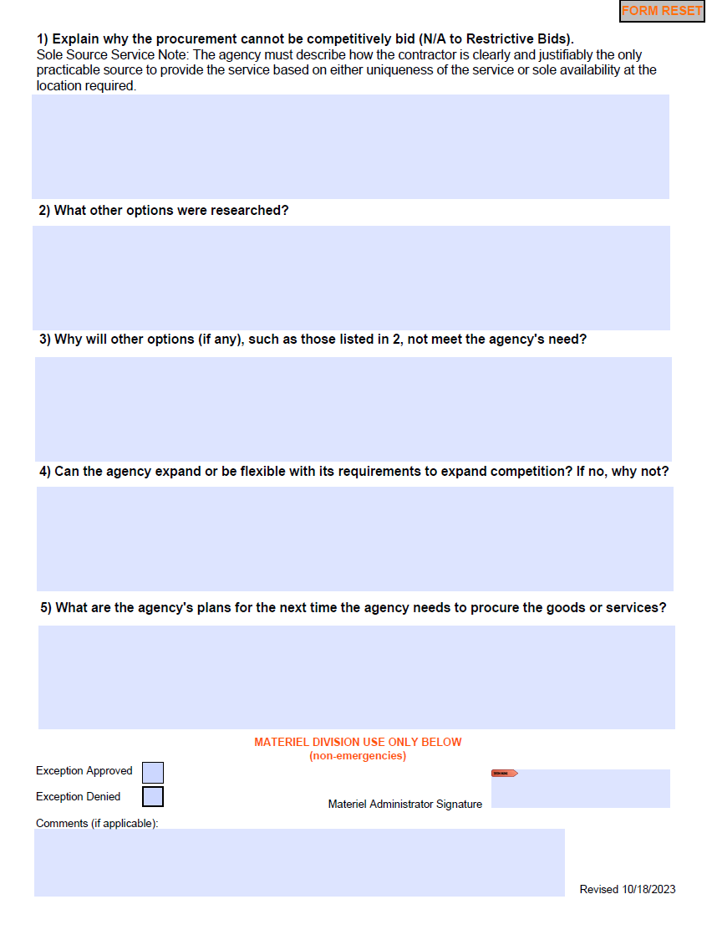
Explanation of exception to the bid process
Exception approval status and Materiel Admin Signature

Slide 62
Suggested Justification Writing Criteria

Slide 63
Provide Context
The Platte River is Overflowing/Flooding

Slide 64
Introduce Why Your Situation Warrants a Deviation
The Flooding has submerged a power station, and knocked over 3 transformers in the nearby town

Slide 65
What is the Contract For?
We need to send an emergency crew out to clear these transformers, as this is a danger to the neighborhood that houses the power station.

Slide 66
Is there a Timeline?
If we do respond immediately/as soon as possible, the risk to public health and safety will greatly increase.

Slide 67
Submitting Deviations in E1

Slide 68
Steps to Submitting Deviation in E1: Commodities
Go to “Purchasing- Agencies” in E1 Navigator
“Requisitions”
Enter Commodities Requisition/
Use the “Add” Function
Populate new fields such as address book, ship to, BU, etc
Click “Additional Properties” Tab
Populate New fields such as document description, document location, contact
Click “Category Codes” Tab
Populate New fields such as new/renew/ extension etc
Click “Ok” icon
Enter applicable information such as the NIGP code, Quantity, UoM, Unit Cost, etc
Lateral scroll to “Dev Request”
Enter Through SPB (OW)

Slide 69
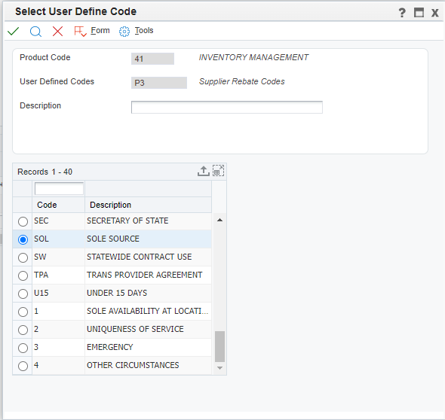
Steps to Submitting Deviation in E1: Commodities (Cont.)
Identify request:
1. Sol – Sole Source
2. Res (restrictive)
3. U15 (under 15 days)
4. Other Circumstances
5. EMR (Emergency Orders)
Add Header Attachments
Click “Ok” Button
“O” will be displayed in the “Previous Order” Field- Take Note!
Close, and repeat as needed

Slide 70
Steps to Submitting Deviation in E1: Services
Go to “Purchasing- Agencies” in E1 Navigator
“Deviation Request”
Enter a Deviation Request (O8)
Use the “Add” Function
Populate new fields such as address book, ship to, BU, etc
Click “Additional Properties” Tab
Populate New fields such as document description, document location, contact
Click “Category Codes” Tab
Populate New fields such as new/renew/ extension etc
Click “Ok” icon
Enter applicable information such as the NIGP code, Quantity, UoM, Unit Cost, etc
Lateral scroll to “Dev Request”

Slide 71
Steps to Submitting Deviation in E1: Services (Cont.)
Identify request:
1. SS - Location
2. SS Unique Service
3. Emergency
4. Other Circumstances
Add Header Attachments
Click “Ok” Button
O8 # will be displayed in the “Previous Order” Field- Take Note!
Close, and repeat as needed

Slide 72
Header Attachments for E1
The deviation request must include the following:
Attachment of the draft contract,
Estimated dollar value of the contract,
Agency Director’s approval via Approval Routes
Justification, included in an attachment.
This is a link to the PFC that has an E1 Procedural Guide on this Process for Services
Proof of Need

Slide 73
Submitting for Emergencies
For emergencies, the following are needed
A copy of the contract signed by the vendor and agency director must accompany the deviation request.
Once the data has been entered into a Request for Deviation from Service Contract and it has been approved, the document will be generated into an “Exempt Purchase Requisition for Services (Z6) or Services Contract (O4)” and processed by the Agency.
Note: Emergency commodities need consent by the governor

Slide 74
Let’s Recap

Slide 75
Deviations: What We Went Over
Overview of “Normal Procurement”
Laws and Statutes (Chap. 73 and 81)
Defining “Deviation” in PT Process
Co-op, Sole Source, Emergency, GSA
Required Deviation Forms
Submitting in E1
Examples/ Justifications in E1

Slide 76
Do You Have Questions About Deviations?

Slide 77
Deviations Resources

Slide 78
Deviations Resources
DAS Procurement Manual
DAS/SPB Policies, Manuals, Reports
Nebraska State Statute Chapter 73
Nebraska State Statute Chapter 81
Unrestricted Market Purchase Authority Document (FY 2023/24)
08 Deviation Request Guide
SPB Front Desk
402-471-6500
as.materielpurchasing@nebraska.gov

